Slide 1
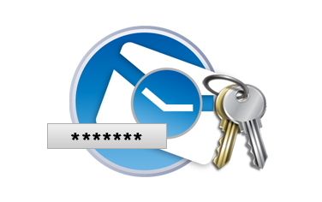
Key-Derivation Functions (KFD)
Scrypt
PBKDF2
Bcrypt
Argon2
Securely Deriving Key from a Password

Slide 2
Deriving Encryption Key from Password
Encryption often uses passwords instead of binary keys
A key-derivation function (password → key) is needed
Using SHA-256(password) as key-derivation is insecure!
Brute-force / dictionary / rainbow attacks may reverse the hash
PBKDF2, Bcrypt, Scrypt and Argon2 are significantly stronger
Secure key-derivation functions use salt + many iterations
It takes CPU time to derive the key (e.g. 0.2 sec) + memory (RAM)
Cracking passwords will be slow (e.g. 5-10 attempts / second)

Slide 3
Key Derivation Functions: PBKDF2
PBKDF2 is a simple cryptographic key-derivation function
Based on iteratively deriving HMAC many times
Described in RFC 2898 (PKCS #5) – http://ietf.org/rfc/rfc2898.txt
Input data for PBKDF2:
password – array of bytes / string, e.g. "p@$$w0rD~3"
salt – securely-generated random bytes, e.g. "dfc66e9c5…1b63"
iterations count, e.g. 1024 iterations
hash-function for HMAC, e.g. SHA256
derived-key-len for the output, e.g. 256 bits

Slide 4
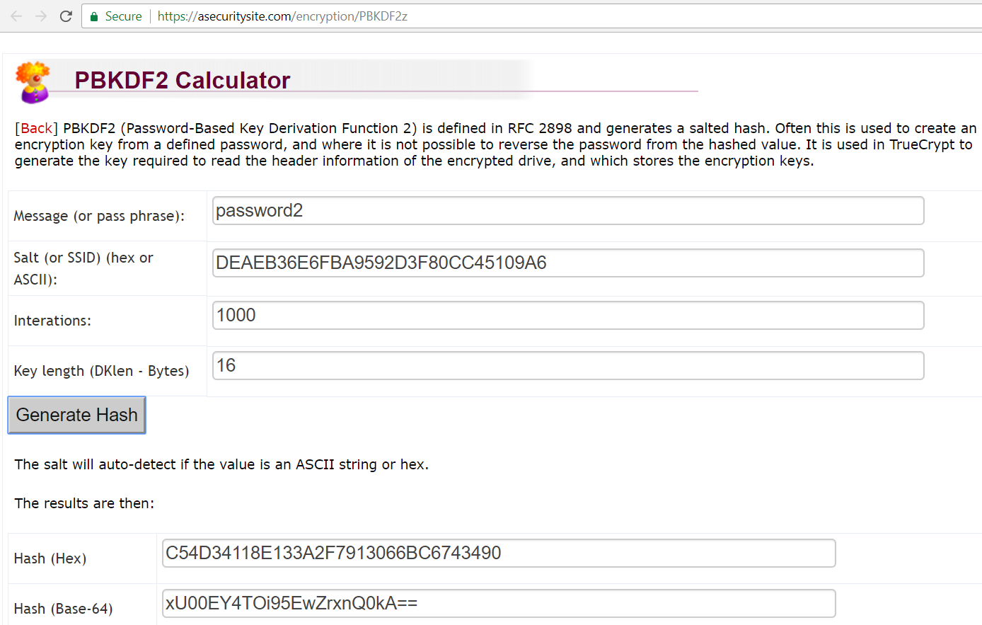
PBKDF2 Key Derivation
Live Demo
https://asecuritysite.com/encryption/PBKDF2z

Slide 5
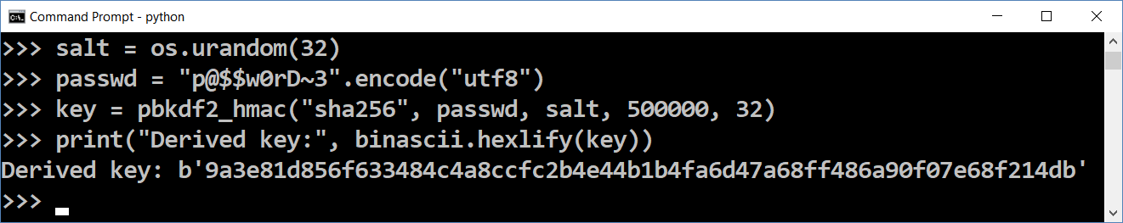
PBKDF2 Key Derivation in Python – Example
import os, binascii
from backports.pbkdf2 import pbkdf2_hmac
salt = os.urandom(32)
passwd = "p@$$w0rD~3".encode("utf8")
key = pbkdf2_hmac("sha256", passwd, salt, 500000, 32)
print("Derived key:", binascii.hexlify(key))
pip install backports.pbkdf2

Slide 6

Key-Derivation Functions (KFD)
Try the Code!

